Slide 1
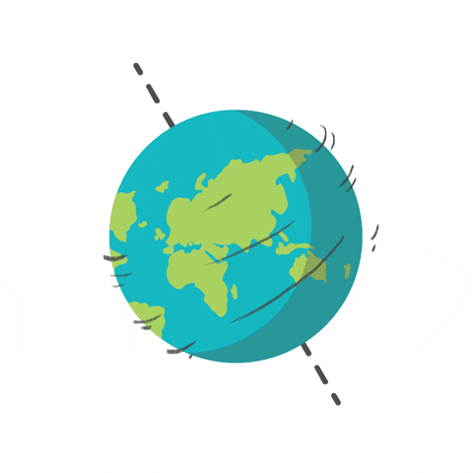
Global Quiz
There are four rounds
Five questions per round
Only ONE winner….

Slide 2
Round 1: Food Round – in which country are these dishes traditionally eaten?

Slide 3
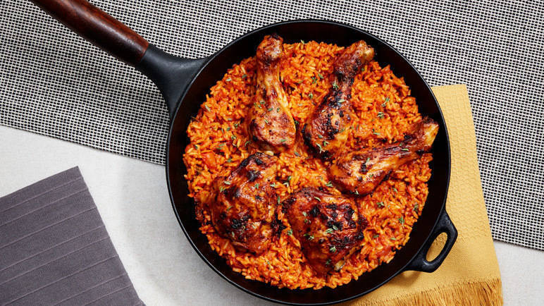
1) Jollof Rice – A spicy tomato one-pot rice dish perfect with chicken

Slide 4
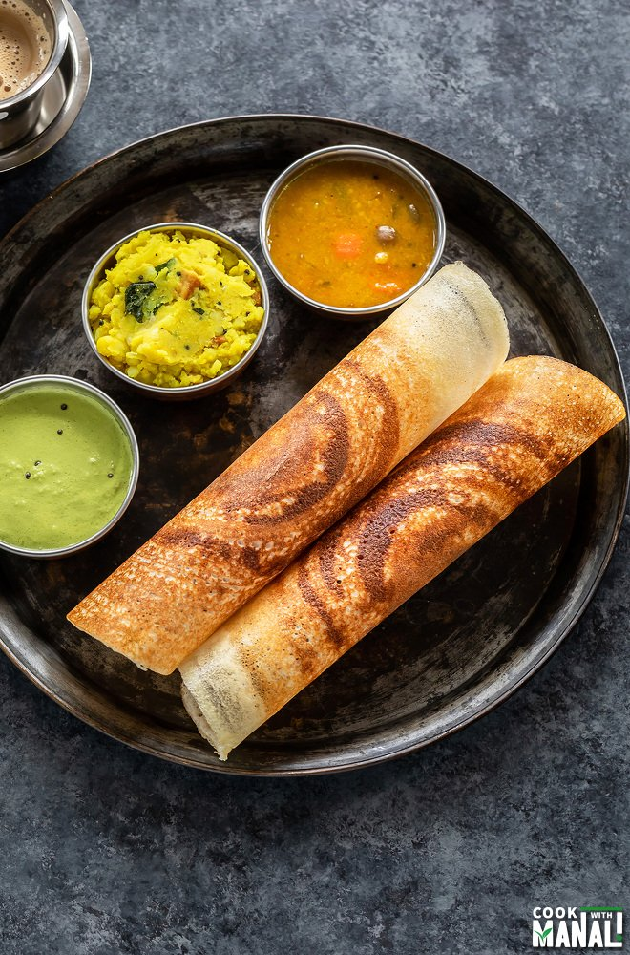
2) Masala Dosa - A thin and crisp fermented batter pancake with a spicy potato filling. Usually served with a lentil preparation called sambar.

Slide 5
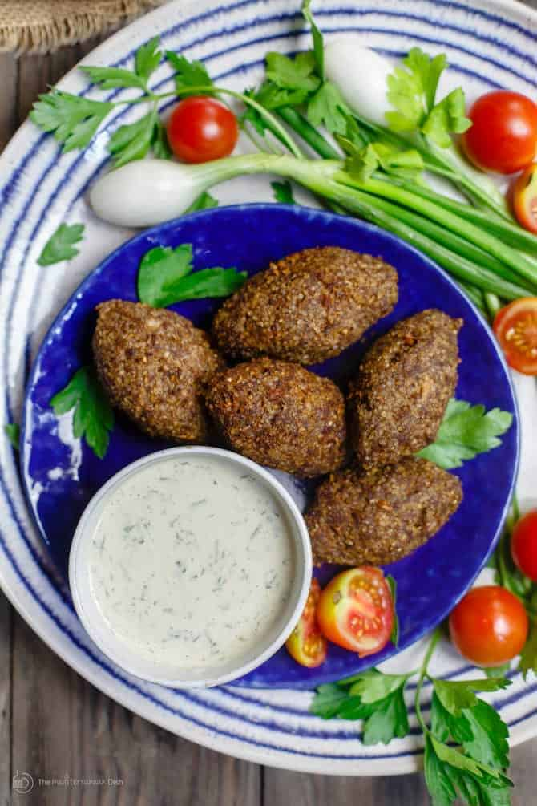
3) Kibbeh - made of bulgur wheat, chopped onions, finely ground meat (beef, lamb), chilies, and spices. Kibbeh can be baked or fried.

Slide 6
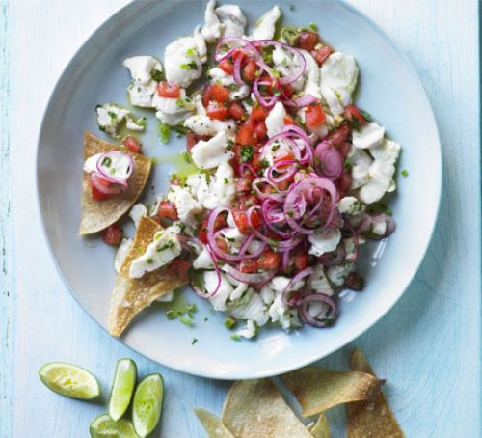
4) Ceviche - Chunks of raw fish marinated in lime juice, mixed with onions, chili peppers, and garlic. Fish bone broth, salt, and pepper are used for seasoning.

Slide 7
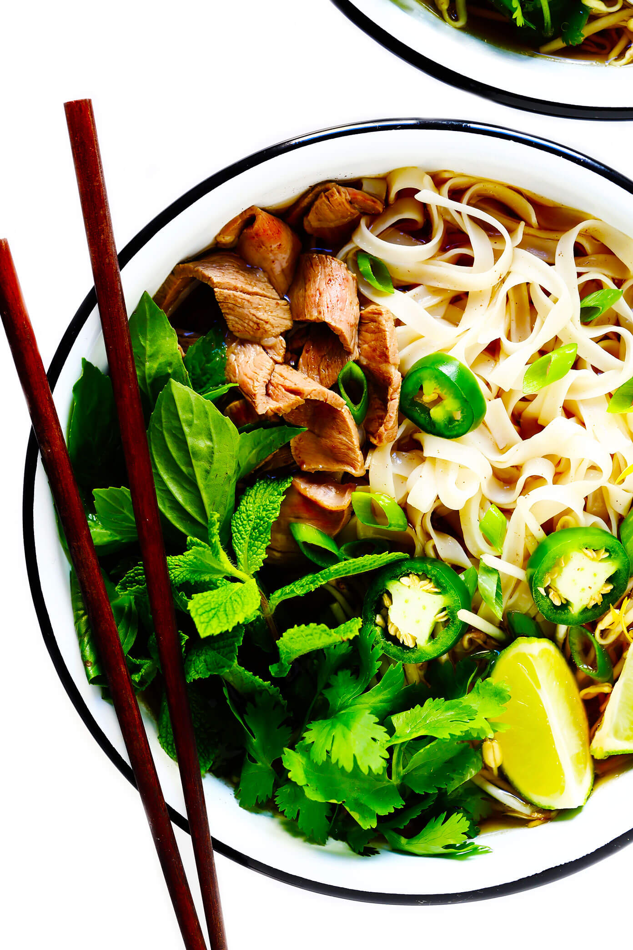
5. Pho - Rice noodles in beef broth seasoned with cumin, coriander powder, black cardamom, roasted onion powder, roasted ginger powder, fennel, and cloves.

Slide 8
Round 2: Flags of the world

Slide 9
1)

Slide 10
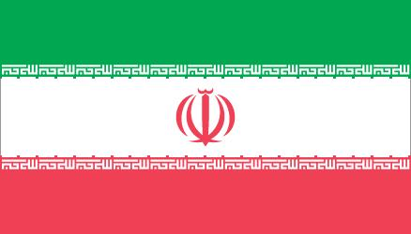
2)

Slide 11
3)

Slide 12
4)

Slide 13
5)

Slide 14
Round 3- Famous landmarks and where to find them!

Slide 15
1)

Slide 16
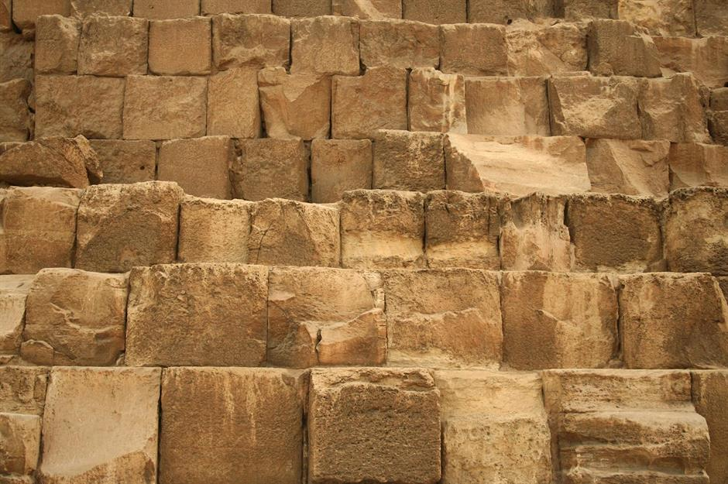
2)

Slide 17
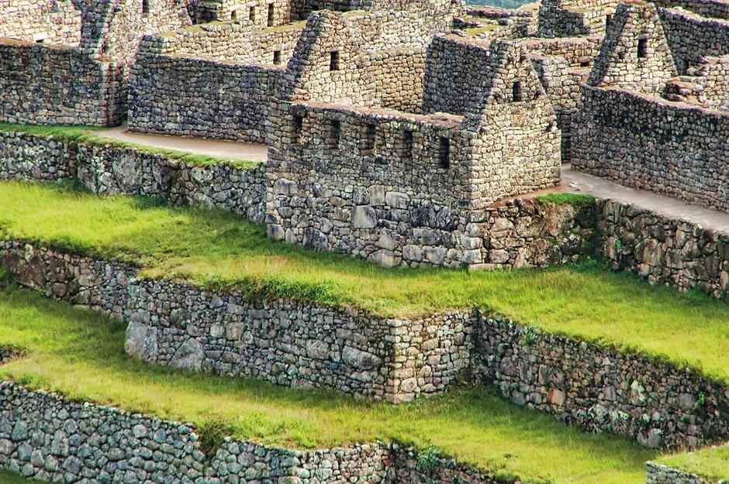
3)

Slide 18
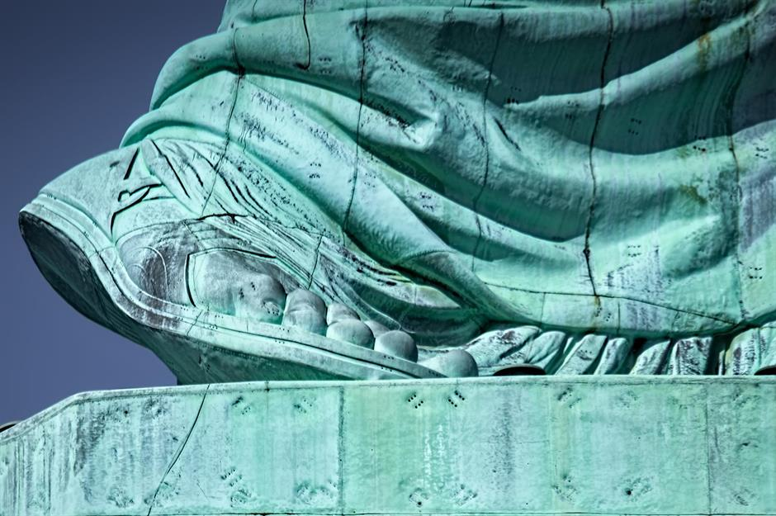
4)

Slide 19
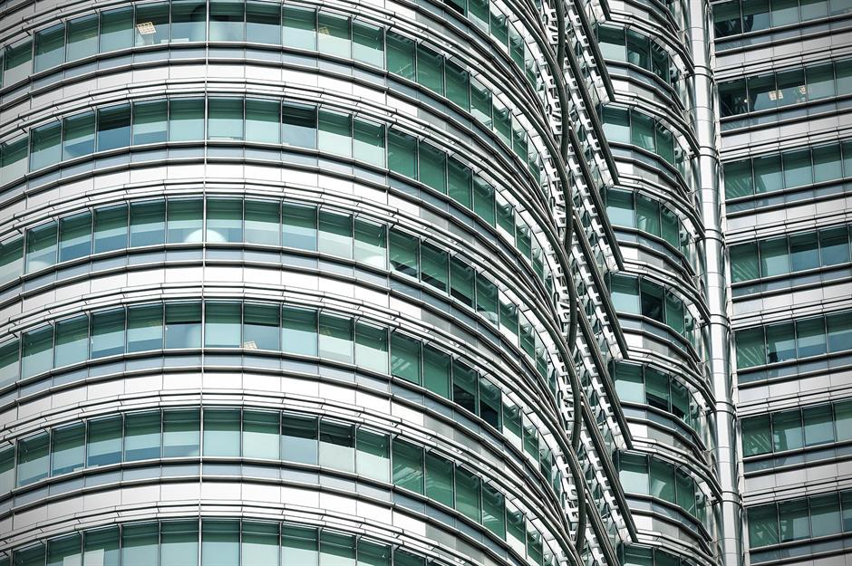
5)

Slide 20
Round 4 - Rockin’ All Over The World..

Slide 21
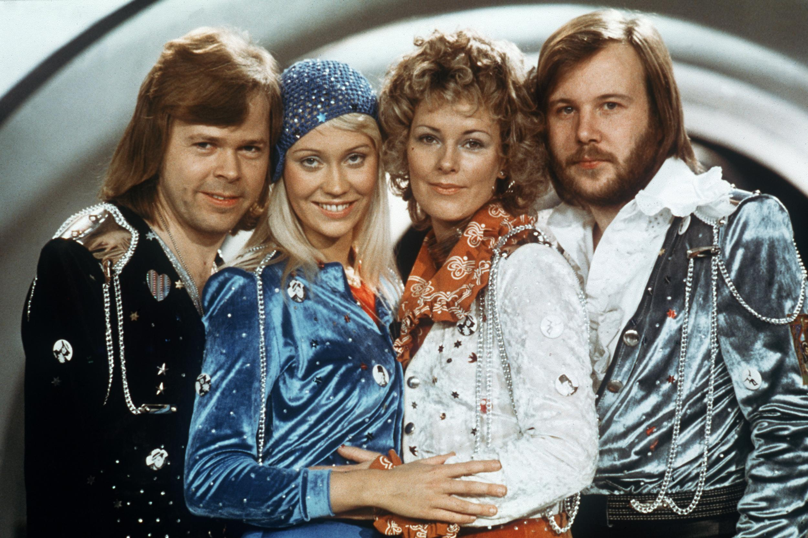
1) ABBA famously won the Eurovision song contest with their hit ‘Waterloo’ … what year was this iconic win?

Slide 22
2) Which country does this national anthem belong to?

Slide 23
3) Can you name this artist and song? Bonus point if you can name the international event that this song was created for!

Slide 24
4) K-Pop is a genre of pop music which originates in what country?

Slide 25
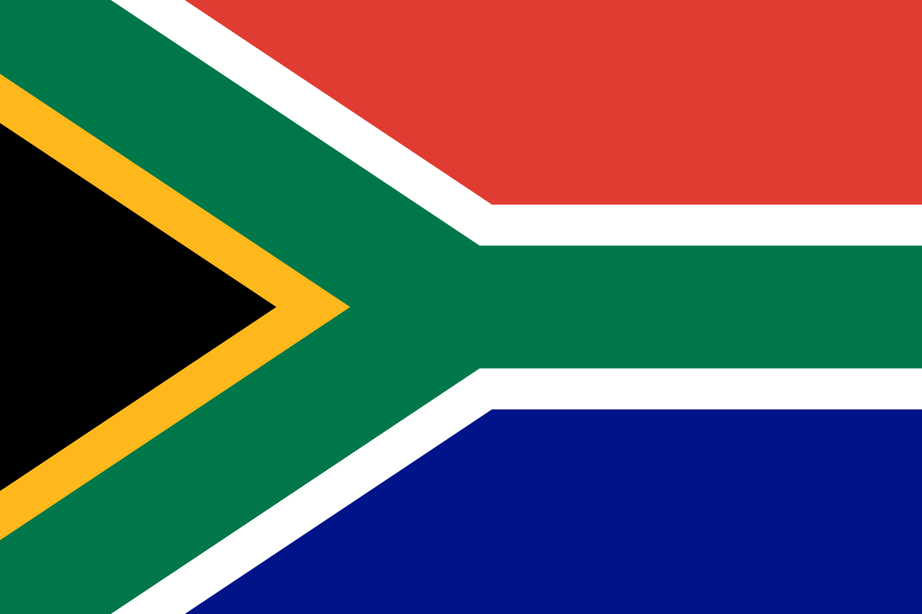
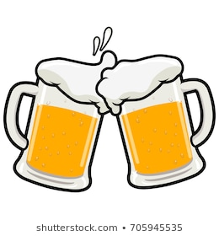
5) Which South African singer had a hit in 1988 with ‘Umqombothi’?

